Slide 1
Welcome
AHS
Class
of
2017
Guidance Counselors
Mary Beth Exner
George Dodier
Susan Saurman
Adjustment Counselor
Rachael Dobbs

Slide 2
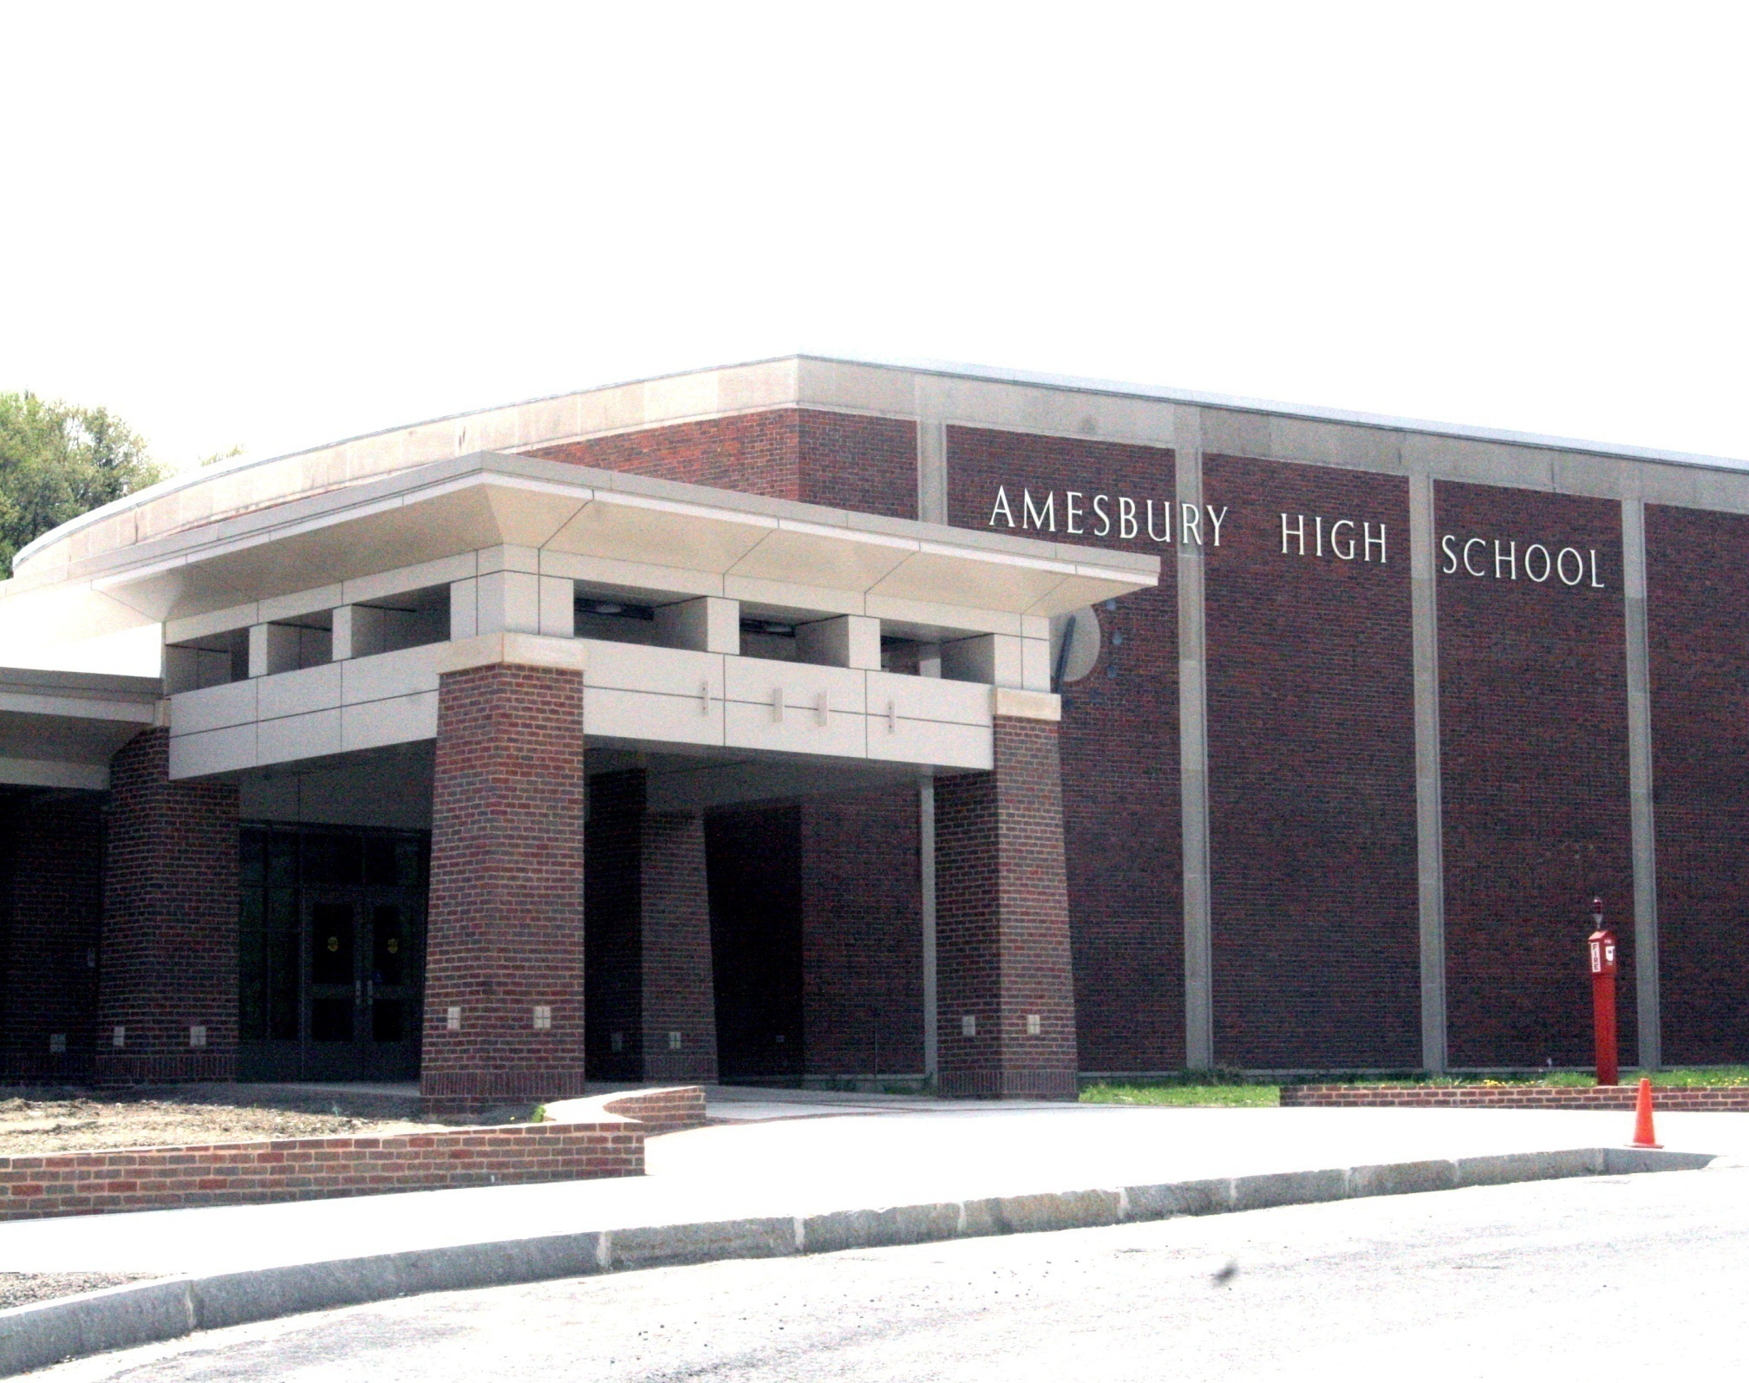

Slide 3
Beliefs on Learning
Core Values
Amesbury High School is committed to inspiring all students to become problem solvers who take responsibility for themselves and their learning. Encouraging this journey toward excellence, the AHS community works together to model integrity, acceptance, collaboration, and respect. School pride permeates the culture of AHS through time- tested traditions blended with student- driven innovations and initiatives.
Integrity
Respect for Individuality
Responsibility
Academic Excellence
Problem Solving

Slide 4
Learner Expectations
Students will:
Academic
Problem Solve by interpreting, evaluating, and implementing solutions.
Communicate effectively in written, oral, and visual forms.
Demonstrate appropriate use and application of media/technology.
Access, comprehend, analyze, and interpret information.
Social
Collaborate effectively in a variety of roles within the school community.
Make positive contributions in their community.
Civic
Demonstrate civic responsibility by advocating for positive change.

Slide 5
Credit Requirements
56 credits over 4 years are necessary to qualify for a diploma.
Students must carry 16 credits per year =
4 classes each quarter

Slide 6
Earning Credits Toward Graduation
Credits can be earned as: 1 credit
2 credits
or 4 credits
Examples: 1) Biology A, 1 Quarter = 1 Credit
2) Spanish, 2 Quarters = 2 Credits
3) AP U.S. History, 4 Quarters = 4 Credits
Students taking Band/Chorus can earn up to 18 credits, all other students have the potential to earn 16 credits per year
56 Credits are required for graduation

Slide 7
Course Requirements
1) 10 Quarters of English
2) 10 Quarters of Math (pending)
3) 7 Quarters of Science
4) 7 Quarters of Social Studies
5) 2 Quarters of Foreign Language
6) 1 Quarter of Child Development
7) 2 Quarters of Technology
8) 1 Quarter of Fine Arts or Hands On
9) 1 Quarter of Health Education
10) 3 Quarters of Physical Education
11) 75 hours of Community Service

Slide 8
Course Levels
Amesbury High School offers courses at various levels for students with different abilities and motivations.
College Preparatory
Early College
Honors
Advanced Placement (AP)
Honors and AP classes have certain requirements which are listed in the Program of Studies.
Course selection will be based on achievement, ability, teacher recommendation and personal preference.

Slide 9
Amesbury High School classes are taken in a block schedule format
Period A 7:22-7:57
Period 1 (Block 1) 8:00- 9:27
Period 2 (Block 2) 9:30-10:57
Period 3 (Block 3) 11:00-1:00
        Lunch A 11:00-11:30
Lunch C 12:30- 1:00
Period 4 (Block 4) 1:03-2:30

Slide 10
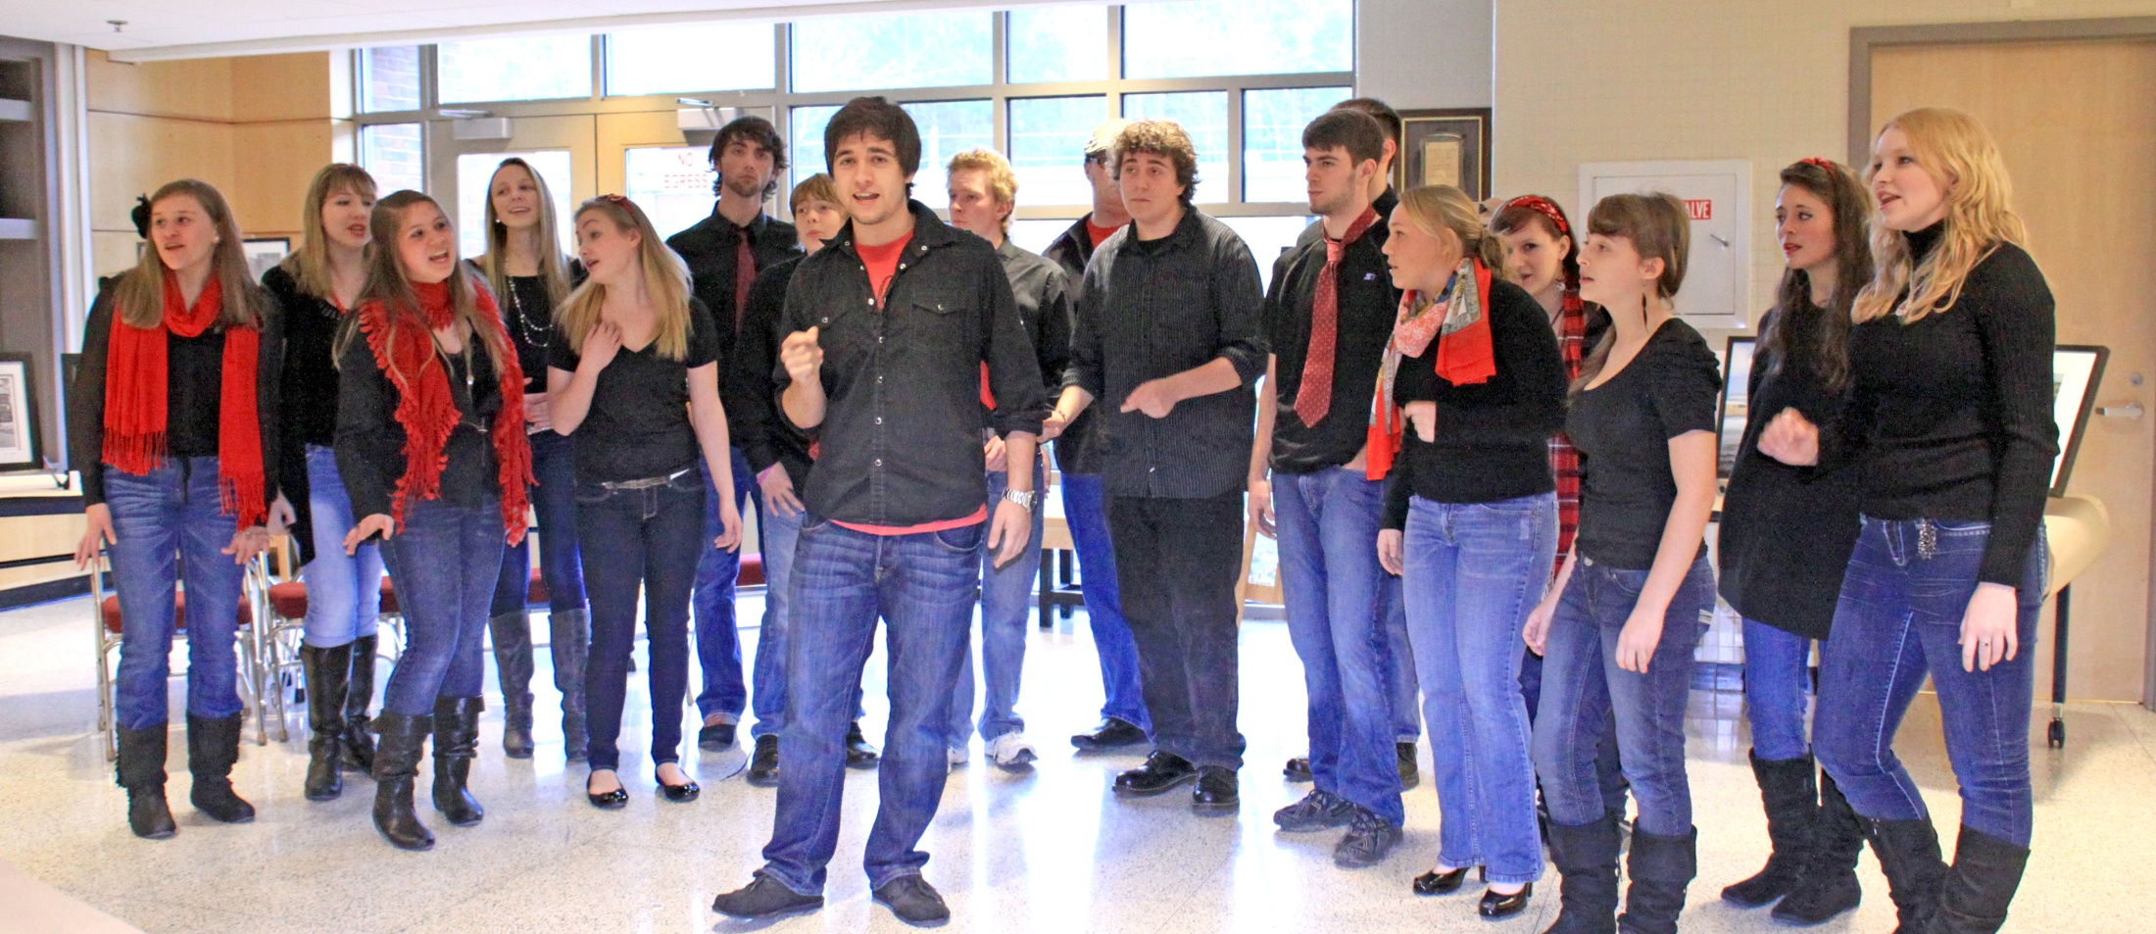
“A” Block
There is one 35 minute period at 7:20 am which is used mainly for Band, Chorus and extra help sessions. This is followed by four periods of 87 minutes.

Slide 11
Sample Schedule

Slide 12
Schedule of Events
January 7th
February 4th & 7th
February 5th
Program of Studies available online at www.amesburyma.gov
Registration at Amesbury Middle School - Snow Dates 2/12 &13
Registration at Barnard School
Snow Date 2/8
Private Schools: Register by appointment with Susan Saurman at saurmans@amesburyma.gov
Student course selections will be available on Aspen the day the student is registered. Barnard students and private school students will receive a copy the day the student is registered.

Slide 13
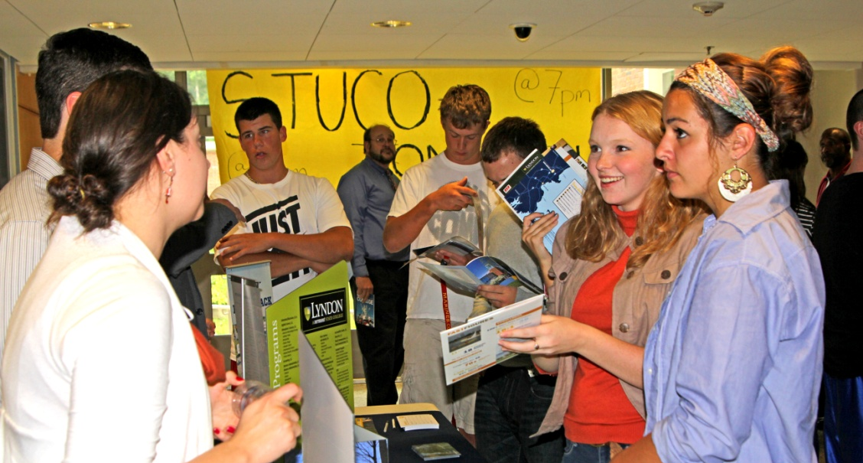
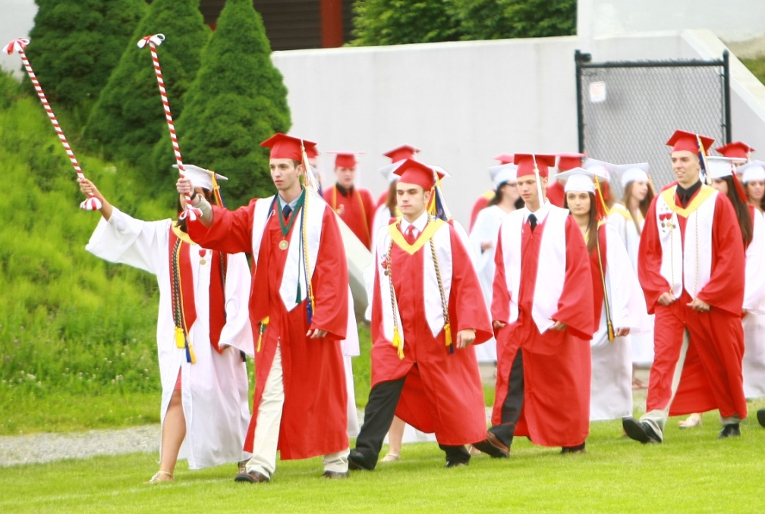
Left: Students talk to a college representative at one of the weekly college fairs held in the fall.
In the Class of 2012,
86% continued their education,
  52% went to four year colleges
  34% went to two year colleges
14% went into the military or went directly to work.

Slide 14
Academic Honor Societies
National Honor Society
Quill and Scroll Honor Society
Rho Kappa National Social Studies Honor Society
Mu Alpha Theta
Tri M Music Society
French/Spanish Honor Society
National English Honor Society
Science National Honor Society

Slide 15
Dual Enrollment Opportunities
Partnership with Northern Essex Community College
&
Salem State College
Introduction to Psychology
Introduction to Sociology
Business Entrepreneurship
English Composition I
Anatomy and Physiology I

Slide 16

Early College Opportunities
Partnership with Northern Essex Community College
Bridging the Gap between High School and College
• Provides sophomores with the opportunity to take college courses that are integrated into the high school curriculum.
• Gives students a head start in earning college credit.
•College and Career Readiness

Slide 17
On–Line Courses
Amesbury High School students can choose over 100 courses available to them through Mass Colleges On-Line

Slide 18
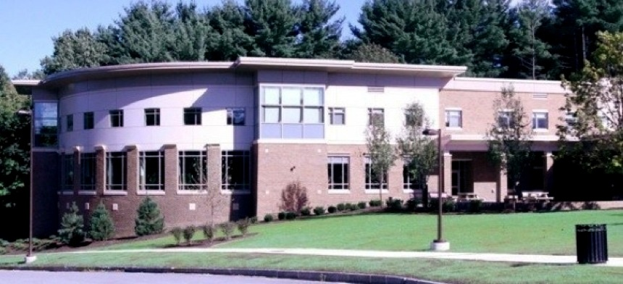
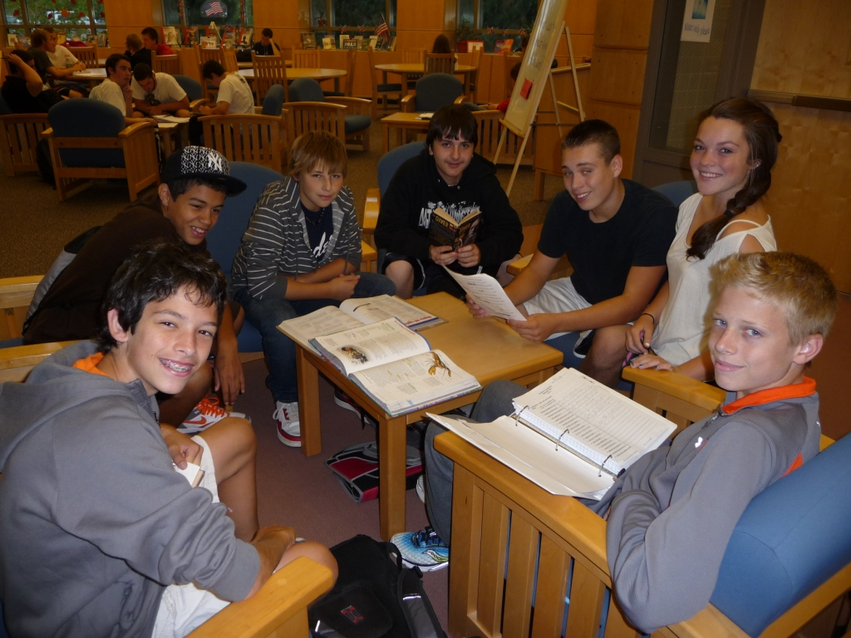
The Roland H. Woodwell Library Media Center
Hours: 7:00a.m. - 3:30 p.m. - The library provides services throughout the entire school day and one hour before school, during lunch, and one hour after school.
Events: Teen Read Week, Book Cover Poster Contest, Book Review Contest, and various raffles
Bookplate Donation Program: An ideal gift and lasting tribute, your donation will support the library’s collection and services while recognizing a special student, teacher, coach, club, or graduate. A customized bookplate will be affixed to books in honor of that special someone.

Slide 19
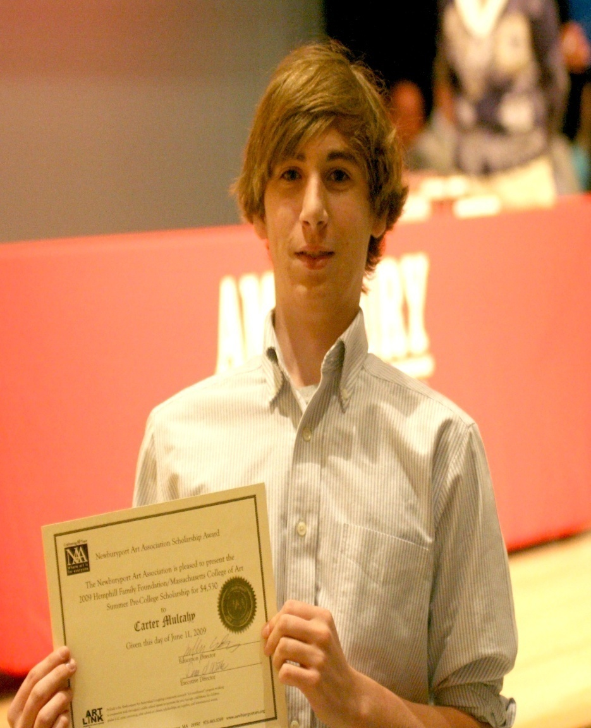
AHS students have many opportunities to earn academic and non-academic awards. These include:
Honor Awards Night for students
on the Honor Roll
Top 10 Banquet for Seniors
Graduation Scholarships
Excellence In Education Awards
Teacher Choice Awards
Superintendent and Principal Leadership Award
Spirit Award
Shining Star Award
MCAS Advanced Scoring Awards
Athletic Awards
Student Council Awards – Local and State
Newburyport Art Association award to Mass College of Art Summer Program

Slide 20
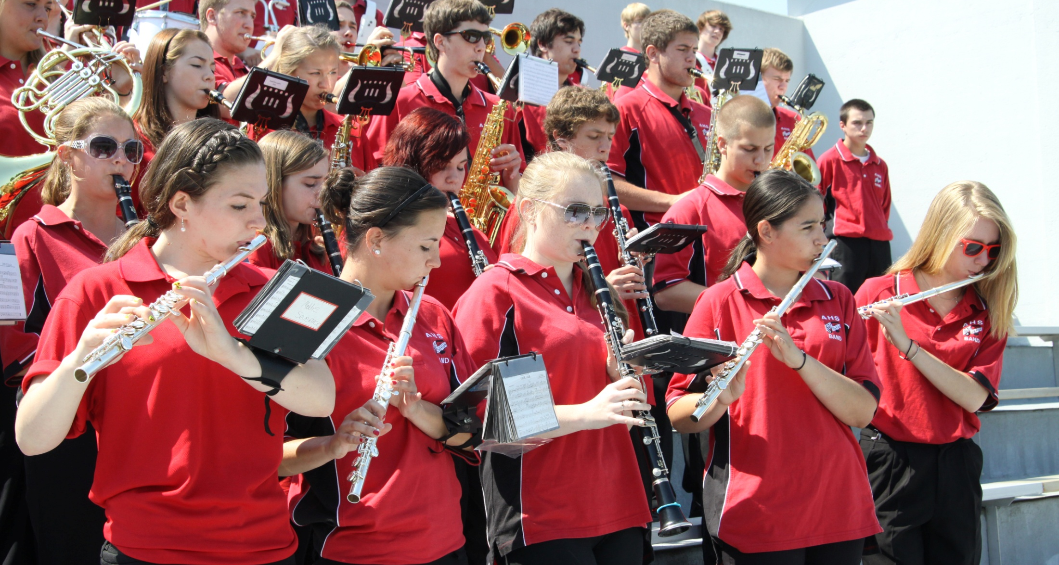
All students need to complete at least 75 hours of community service as a graduation requirement.

Slide 21
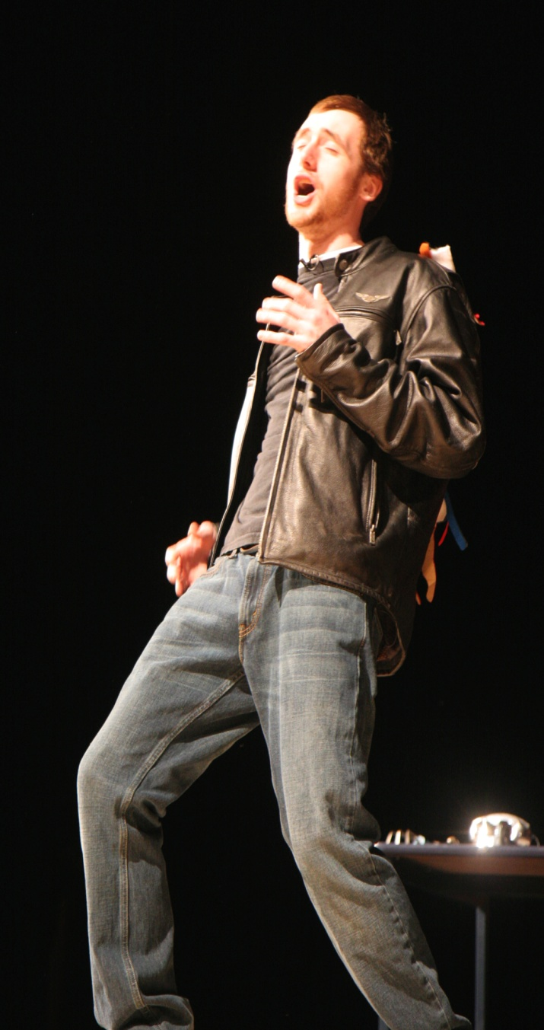
There are many non-athletic co-curricular activities including:
Class Officers
Student Council
Student Advisory Council
AHS Weekly Newspaper
Art and Camera Club
Big Brother/Sister
Drama Club
Environmental Club
Gay/Straight Alliance
High School Quiz Show
Interact Club
Jazz Band
Literary Magazine
Math Team
Peer Leaders
Ping-Pong Club
Science Team
Select Choir
Yearbook

Slide 22
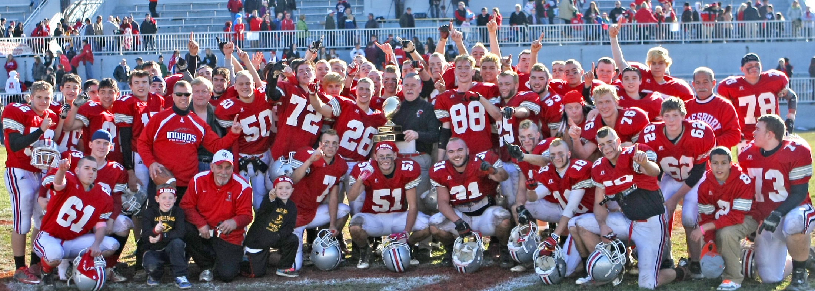
Athletics
Approximately 200 students compete on athletic teams
each season.
Eligibility
Students must pass 3 of their 4 classes to participate.
Sports offered include:
Cheerleading
Cross Country
Field Hockey
Football
Golf
Soccer
Basketball
Ice Hockey
Indoor Track
Co-Op Wrestling
w/Whittier
Baseball
Softball
Tennis
Track and Field

Slide 23
A Look into the Future
Additional Advanced Placement Courses
Increased Electives in Foreign Language, Science, Art, Drama, and Math
Interdisciplinary Courses
Associate Degrees through Northern Essex Community College in Applied Sciences, Engineering, and Early Childhood Education
Increased student-teacher access to technology

Slide 24


Slide 25
Why Amesbury?
Dual Enrollment Program Courses and On-line offerings
Students Nationally Recognized for their Leadership and Academics
Early College
Supportive Staff and Students
Safe Environment

